Slide 1
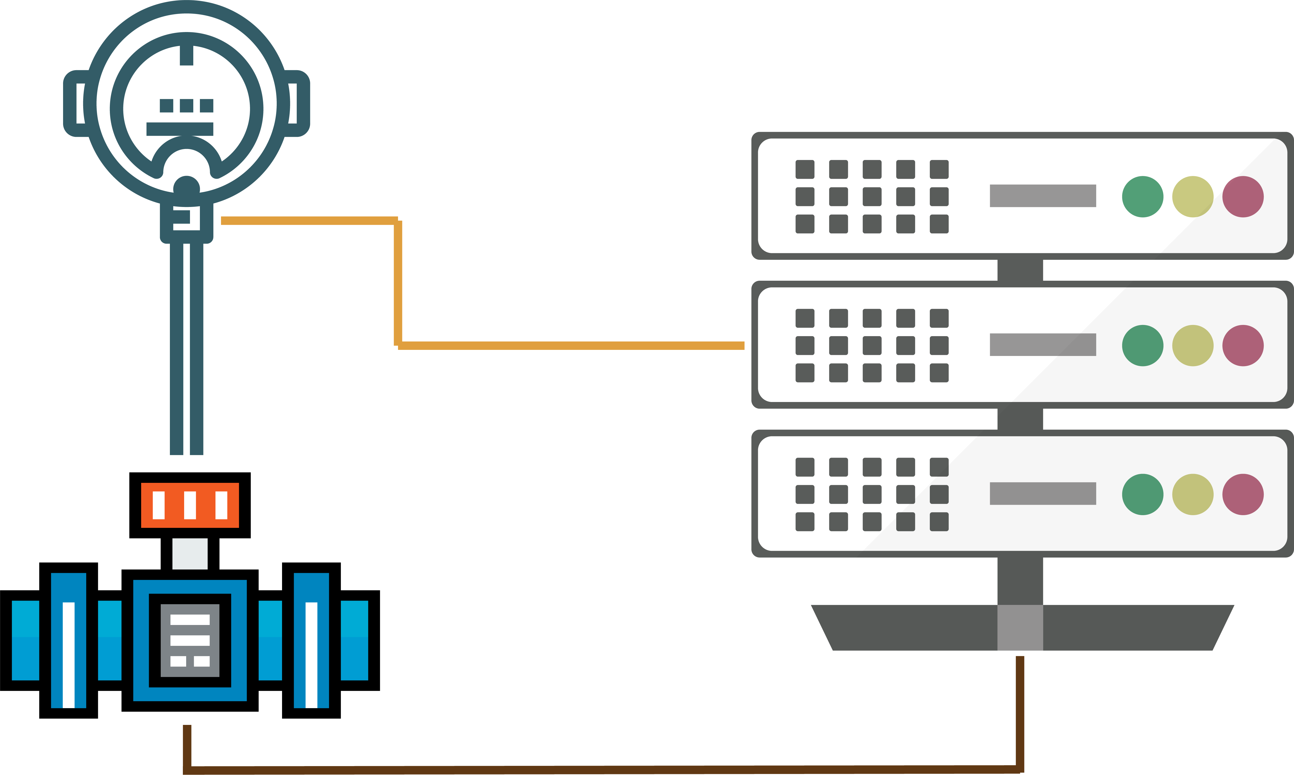
Loop App
Presentation

Slide 2
Agenda
Current Loop Folder workflow.
Disadvantages of current process.
Motivation Plan.
Advantages.
Case Scenario.
Business Process.

Slide 3
1- Loop workflow (Current) With Application Layer
Engineering design the ILD and make the Red Line.
Information stored from SPI to Excel files.
Phase 0
Information stored from Excel files to HCS.
Phase 1
Scope of work collected from engineering in a post process then being updated for production by Subcontractors.
Send Production.
Not a phase in the loop flow
Raise a RFI to QC
Inspect the required element, sign the certificate and send it to HO to load it to the system.
Phase 2
Prepare the physical folders with all signatures, inform Precomm that the folder is ready.
Validate the folder and perform the loop.
Phase 3
Unbound data connection or information transfer by mails

Slide 4
2- Disadvantages of current process.
Collaborated data is pulled instated of pushed which is takes time to send and retrieve the mails.
Engineering site instructions or Red lines are not transparent to all the Loop flow key persons.
Items Certificates in HCS are not transparent to construction team at any time but only when there a missing RFI has to be done.
No blockage good of control, but only in the War room meeting when QC/Precomm declare they have a blockage.
No single source of truth for the loop folders, but it is divided into engineering loop diagram, lists, site instructions mails, HCS and QC system.
Preparing the RFI for the loop folders is randomly as per the raising from subcontractors, so generating work front is randomly in return.

Slide 5
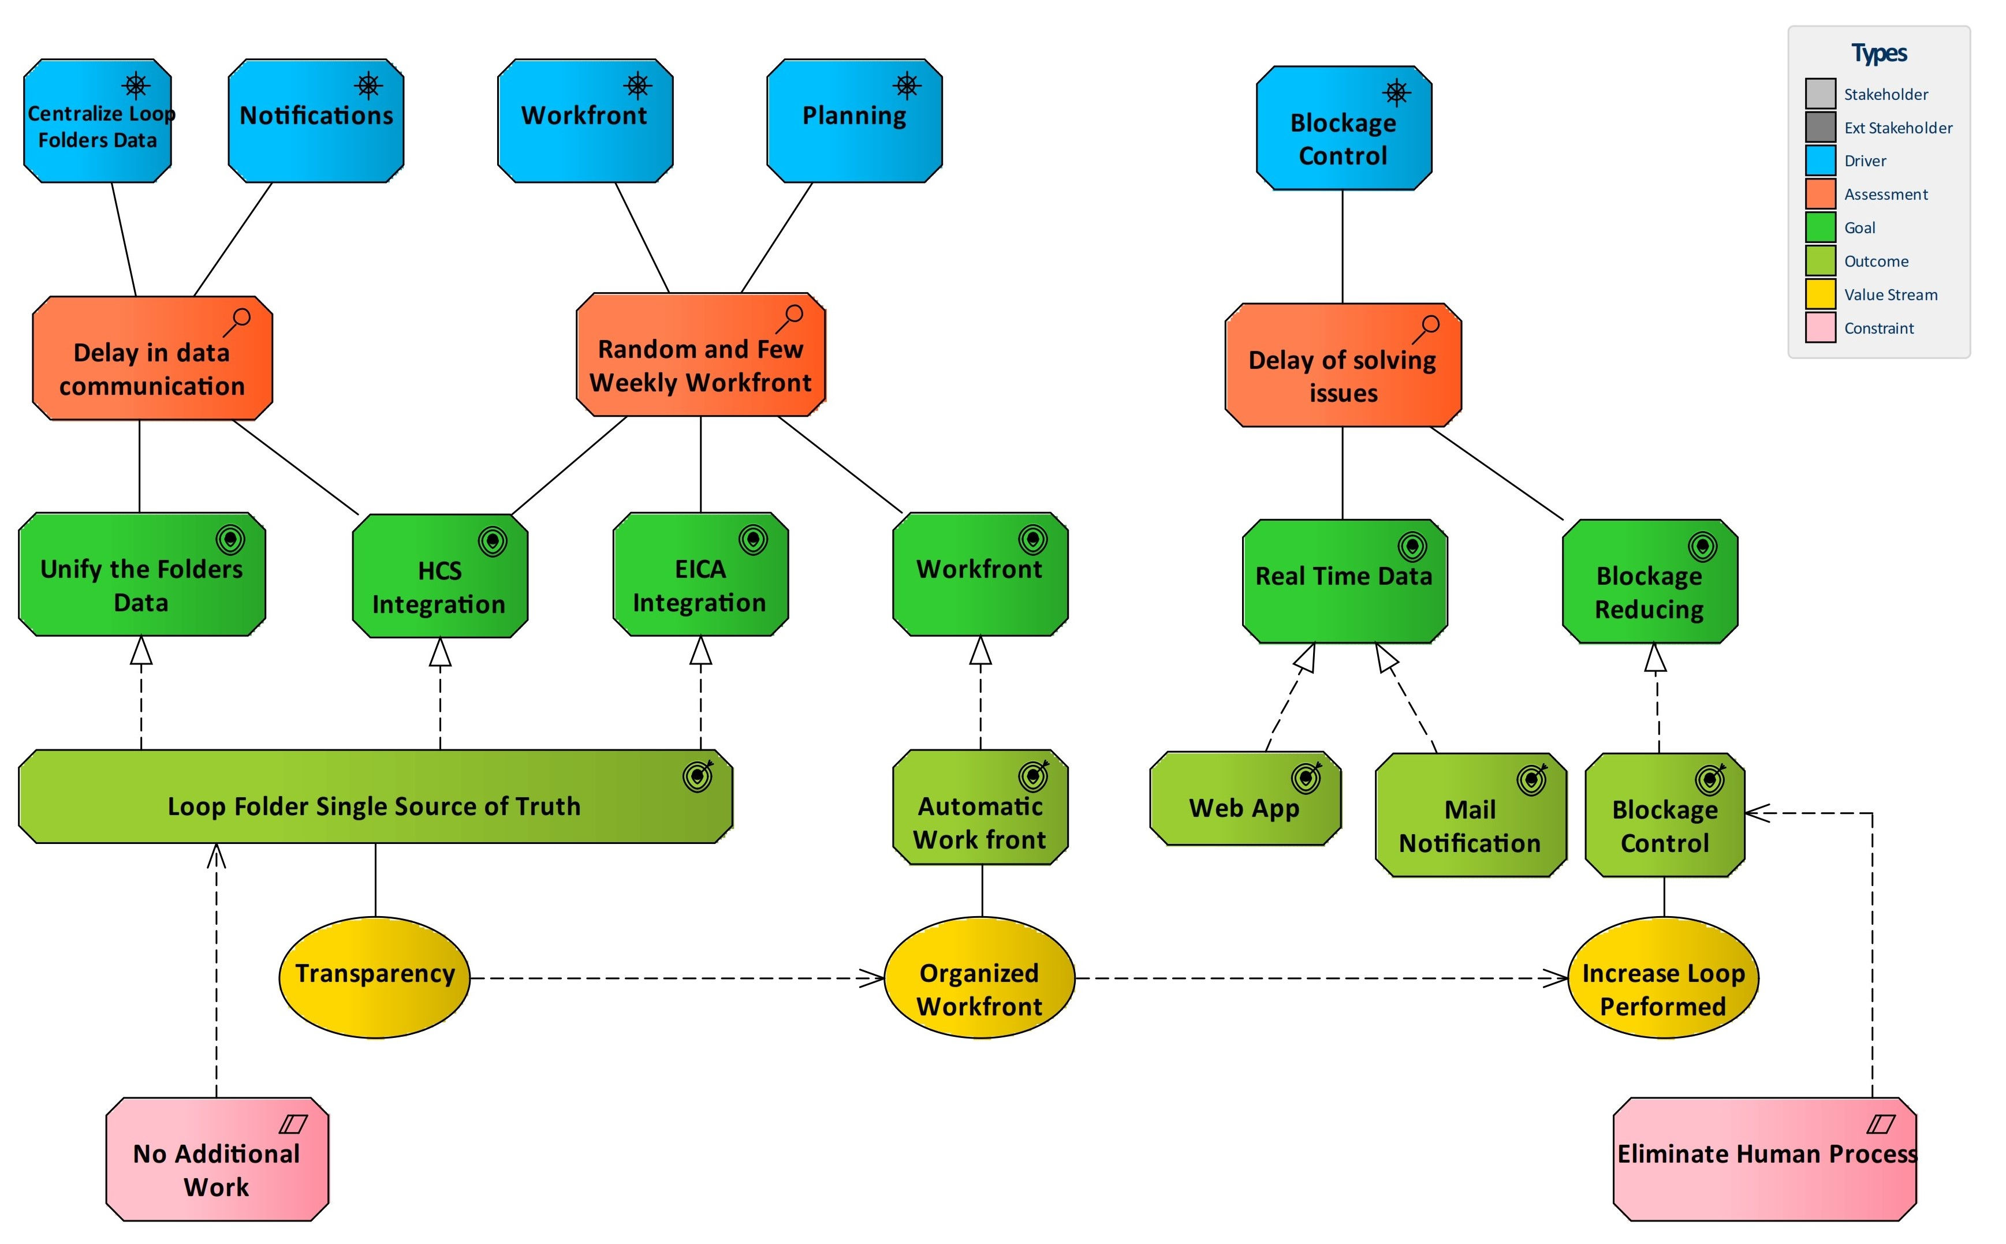
3- Motivation Plan

Slide 6
4- Advantages
Real Time State. Any change on Loop folder/Item is visible on the same time to all the users.
Before Engineering make Red Line he can check the status for the elements related to the loop.
Construction Team and Subcontractor know exactly what RFI has to be done in advanced.
No wait for any meeting to declare a blockage. The declaration goes immediately to responsible.
QC will find all the information in one place. (No mails No Excel files)
QC does not have to send any mail to Pre-comm requesting carry the folder on, once they approve in the system notification will go immediately to pre-comm team.
HCS does not have to inform any one by mail about the status for the elements or groups. The system is integrated with HCS and will do the job automatically.
Reverse Engineering can be used to generate a bulk loop folders work front In advanced.
Construction can view and update items in one click (With respect of production cutoff date).
Collaboration over Mail and Meetings Negotiation.
Reverse Engineering
Instant of reaching the point that Pre-comm has no work front due to a separate items released by construction we can focus earlier to generate work front.
1- planning assign priority to loop folders.
2- ILD is loaded to the system.
3- in return Loops priority is assigned to items.
4- Subcontractors can be guided to focus in this priority and there is a blockage it can be tracked and resolved in advanced.
By doing so we will be sure when Precomm has started it has a bulk of work front to perform.

Slide 7

5- Case Scenario - QAQC
Items Certificates transparent to QAQC.
Track what is pending per each loop.
When release any folder an automatic mail being send to all key person.
Working on schedule from the beginning.
Production is transparent to QAQC.
If Block Then assign a responsible.
Real Time Data.
QAQC Before
Request Items Certificates from HCS by Mail.
Tasks finished are not organized.
Prepare the folder and notify Precomm by Mail.
No Clear work-front.
Items production is not visible to QAQC.
If Block Then Stop.
QAQC After

Slide 8
5- Case Scenario - Precomm
A good amount of work-front have been generated in advanced.
Folder can be tracked at any stage.
Eliminate mail by one single app.
If Block Then Assign responsible.
Single source of Truth for the loops.
Precomm Before
Few Random work-front generated in weekly basis.
Folder status is not visible until it becomes with Precomm.
If Block Then Stop.
Communications done By Mail.
Store the information in Excel files.
Precomm After

Slide 9
5- Case Scenario - Subcontractor
Allow subcontractor to Collaborate as one big team.
Receiving blockage in real time.
Tasks are visible.
Can create blockage and assign responsible.
subcontractor Before
Production at site not as per loop’s priority.
Receiving blockage to be resolved in weekly basis.
Tasks are not visible.
Blockage for subcontractor are not visible to the team.
subcontractor After

Slide 10
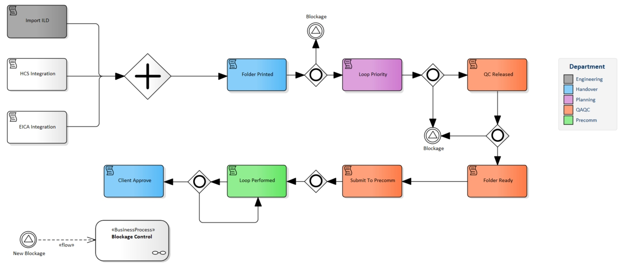
6- Business Process

Slide 11
Thank you!

